Slide 1

INSURANCE POLICY MANAGEMENT
Batch : 18
GROUP : 4
Team lead: Konduru Jaswanth

Slide 2
Team Members
Employee ID | Name
2530153 | Karthikeyan X
2528719 | Keerthna Annadurai Jaya
2527893 | Konduru Jaswanth
2528687 | Konduru Karthik
2527008 | Kshitij Singh
2527989 | Makeswari Sivakumar
2527336 | Mekapothula Sai Sathwik
2528467 | Mogaparthi Surya Teja
2526847 | Mohit Verma
2526712 | Naraayani Nagaraj

Slide 3
Table of contents
Introduction
Tools & Technologies
Use case diagram
ER diagram
User and admin modules
Admin module
User Module
System Overview
Functional Flow
List of Modules
Conclusion

Slide 4
INTRODUCTION
Insurance will help the families in maintaining their standard of living in case if we are not around in the future.
This will help them cover the costs of running the household through the insurance lump sum payout.
The insurance money will give family, some much-needed breathing space along with coverage for all expenditure in case of death/accident/medical emergency of the policy holder.
Many insurance plans come with savings and investment schemes along with regular coverage. These help in building wealth/savings for the future through regular investment.
Here, Developing a model of "Insurance policy management“ were tried and in this system, Users can buy insurance policies based on their need. Users must register in the system in order to purchase plans. Users can purchase insurance policies based on pricing and terms after registering, which enables customers to compare different plans.

Slide 5





Technologies used:
Front end: Angular
Server Side: Spring Boot
Back-end: Hibernate, MY SQL
Server: Tomcat 8.0

Slide 6

USE CASE DIAGRAM:
Login / Create new Account
View / Update / Delete Policy
Approve Policy
User
Admin
View Policy
Apply Policy

Slide 7
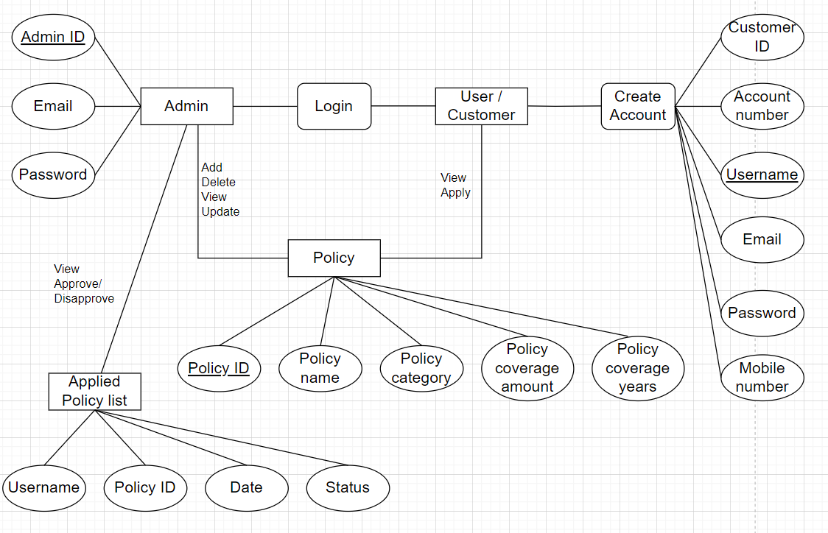
ER DIAGRAM:

Slide 8
OPERATIONS/ Modules:
ADMIN
USER

Slide 9
Login in to portal
View Customers.
View/Add/Update/Delete policy with policy categories like Life, health, vehicle, fire etc.,.
Approve/Disapprove policy applied by customer/ user
View total policy holder, approved policy holder, disapproved policy holder as a list
Log out
ADMIN
MODULE

Slide 10
Create new account.
Login in to the portal
Update Personal details
View policy and apply
Raise queries
Log out
USER MODULE

Slide 11
System Overview:
The “Insurance Policy Management” should support basic functionalities for all below listed users.
Administrator (A)
Customer (C)
Authentication & Authorization:-
Authentication: Any end-user should be authenticated using a unique user-id and password.
Authorization: The operations supported and allowed would be based on the user type. For example, Administrator has the rights to add policy information and view customer details. He can also view policy details and approve/reject policies Whereas Customer/users has a right to view policy and apply for policies.

Slide 12
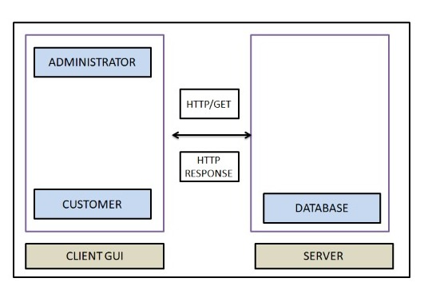
Functional Flow:
The functional flow of the messages across different application components is shown below. Ex. - Web Application.

Slide 13
MODULES

Slide 14
Home Page:
Every application including web application or any other application needs a page called home page or launching page from which the user or the administrator can navigate to all other pages as they need.
In our web application “Insurance Policy Management”, we have designed it with a background video with overlay on the video
And has several options which has been included in the navigation bar which is responsible to navigate over the various pages in the application like admin page, user page and about us page.
The screenshot of the home page is as follows,

Slide 15
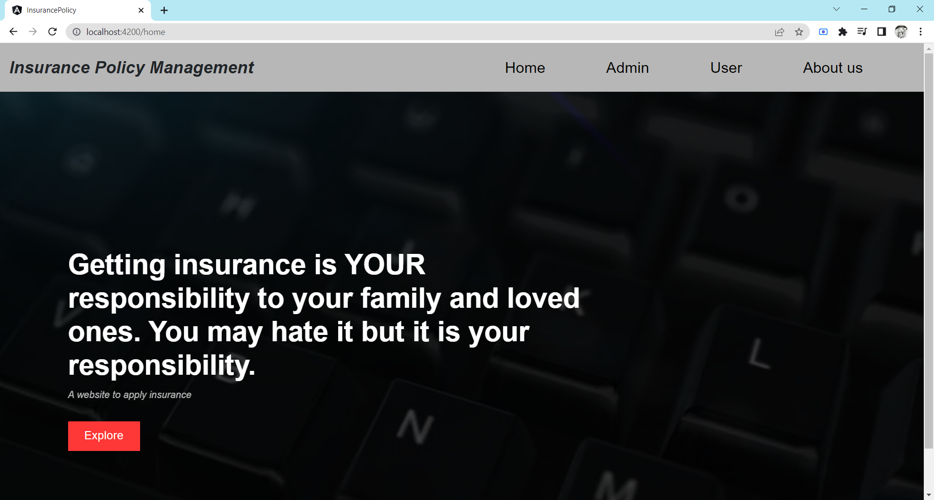

Slide 16
Admin login:
The admin login which is the first will be the important task in our web application “Insurance Policy Management”, which includes admin email and password to login and for navigating to the next page to do further operations
The front end of the admin login has been designed using angular with various components and services and the server side connectivity is carried out using spring boot with the creation of a repository, service and controller.
The screenshot of the admin login page is as follows,

Slide 17
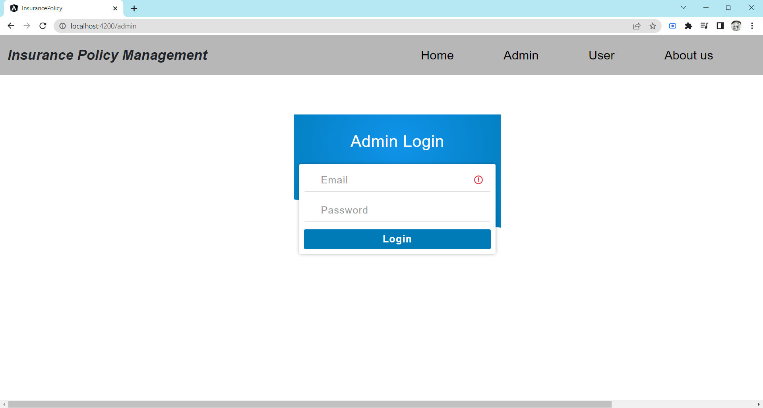

Slide 18
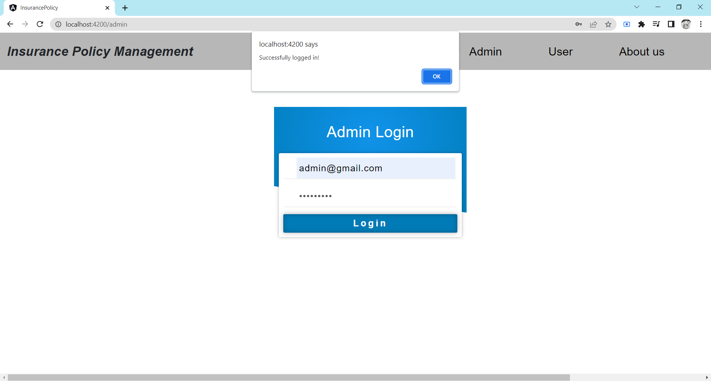

Slide 19
Admin Operations:
Admin home page:
After admin login to the portal, he/she can navigated to the admin home page which includes various options to navigate to the various operations done by the admin like view/ add/ update/ delete polices
Admin - Add policies:
This page which is designed using the angular which acts as a technology to develop code for front end allows admin to add policy to be applied and visible to the user
This includes a form to add policy which contains policy id, policy name along with policy categories like life, health, vehicle etc., policy coverage year and policy coverage amount
The screenshot of the admin dashboard page and admin add policy is as follows:

Slide 20
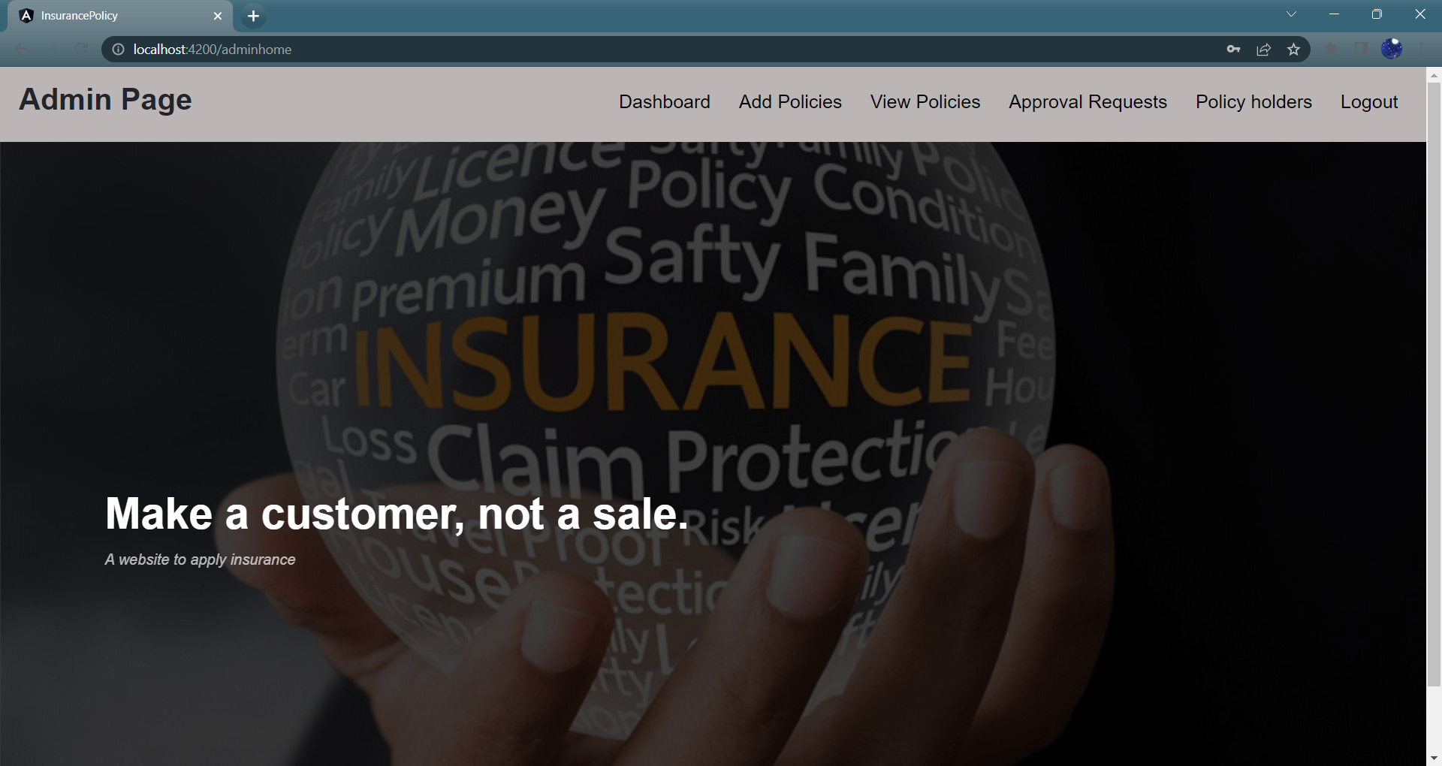

Slide 21
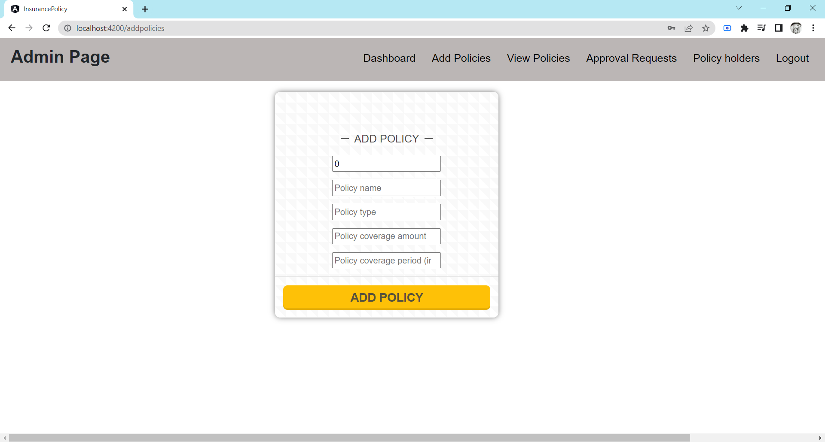

Slide 22
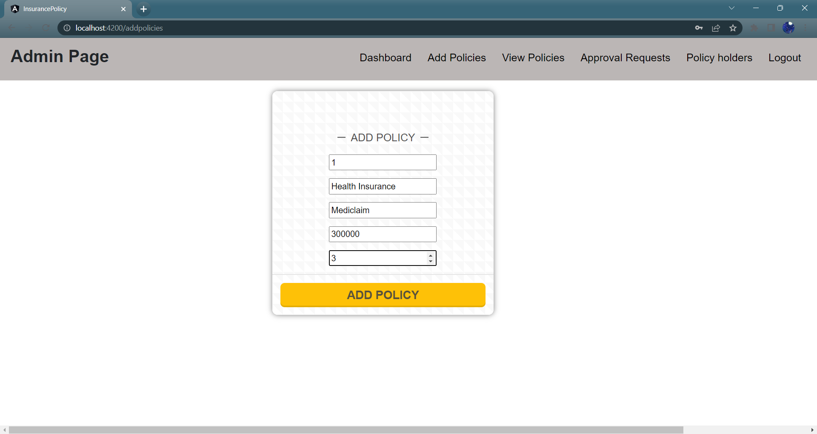

Slide 23
Admin Operations Cont’d,
View Policies page:
After admin login to the portal, he/she can view the policies which has been added by themselves in the view policy page, that shows the list of polices in the table added by them with the option to delete and update that policy
If the admin find the policy is not needed at that particular time or wish to delete that policy, he/she can delete it by clicking on the delete button which is presented in that particular policy with policy information which is added by the admin
Or if the admin find the policy has information which is to be updated for mistaken or needed to be modified, the admin can do that by clicking on the update button on the particular policy which will be redirected to the update policy page which has a form to update the policy
The screenshot of the view policies page is as follows:

Slide 24
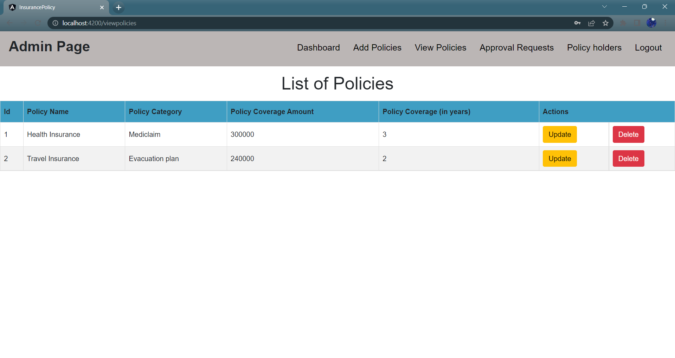

Slide 25
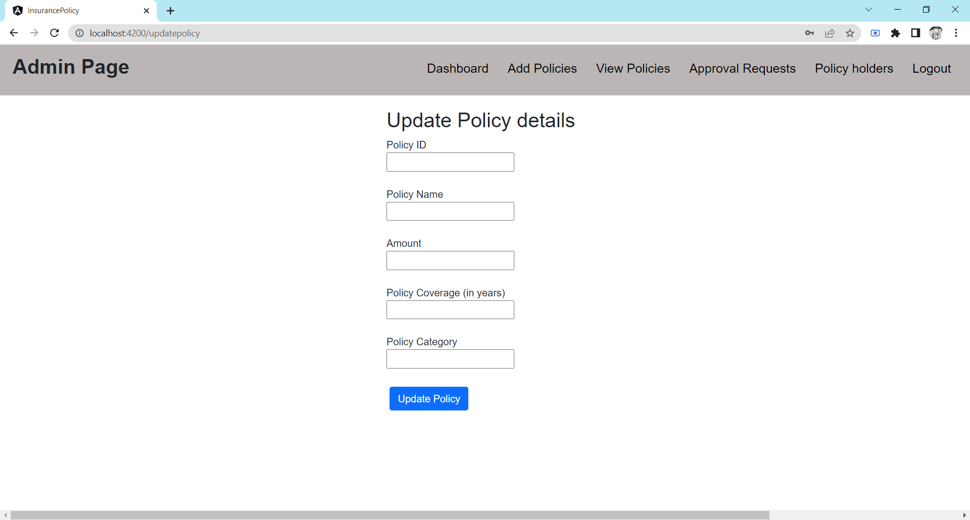

Slide 26
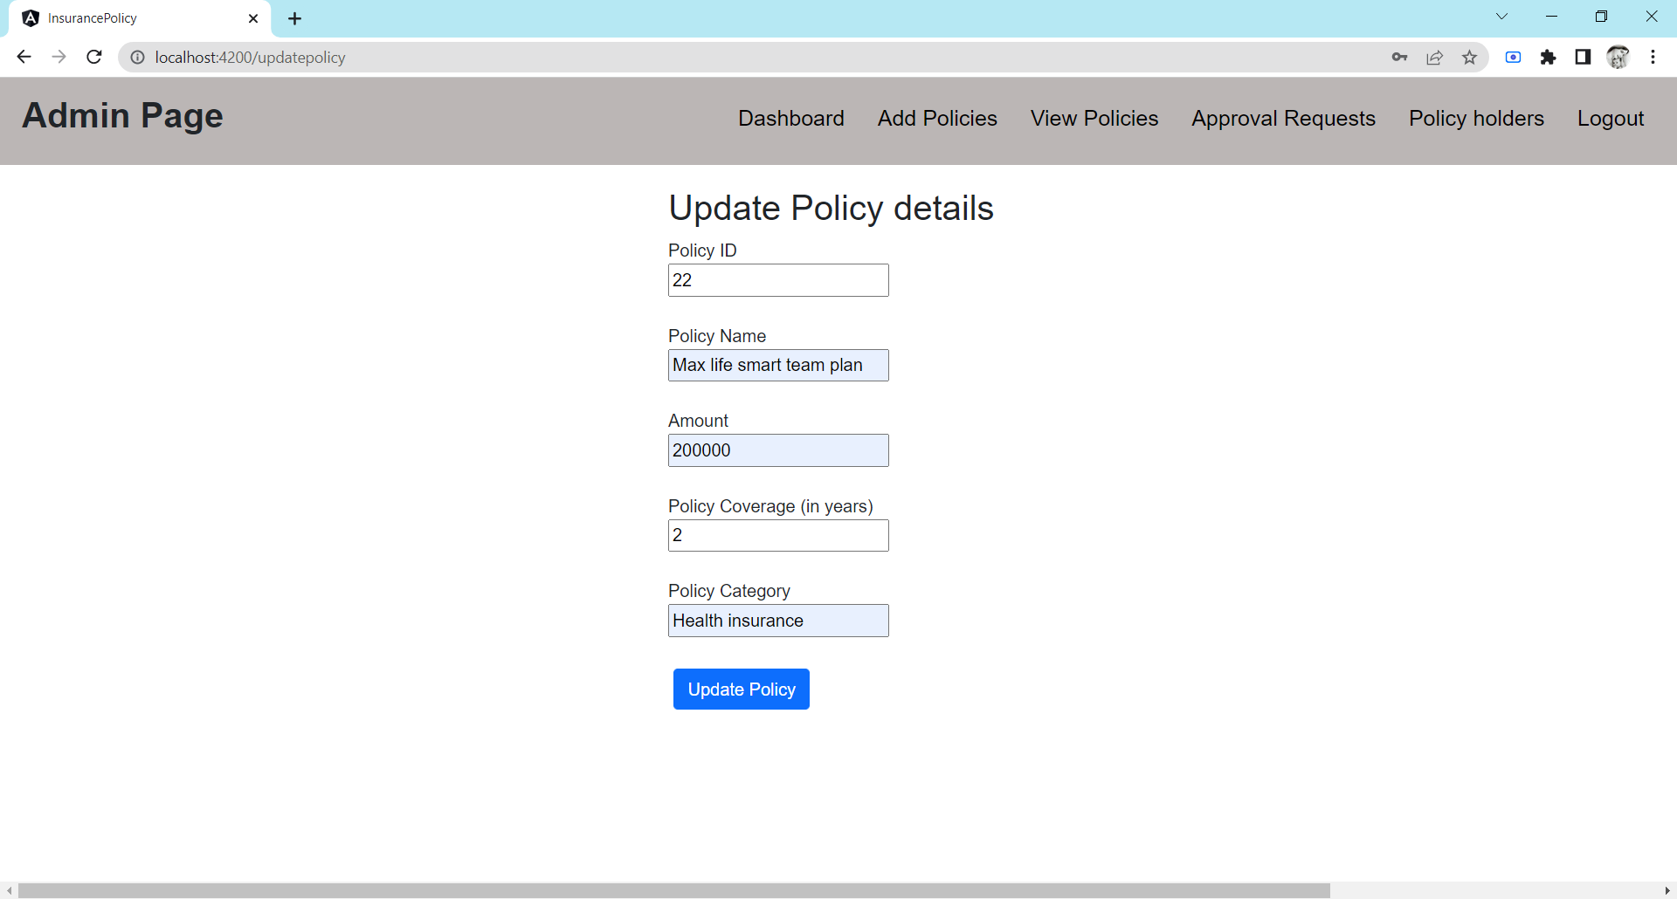

Slide 27
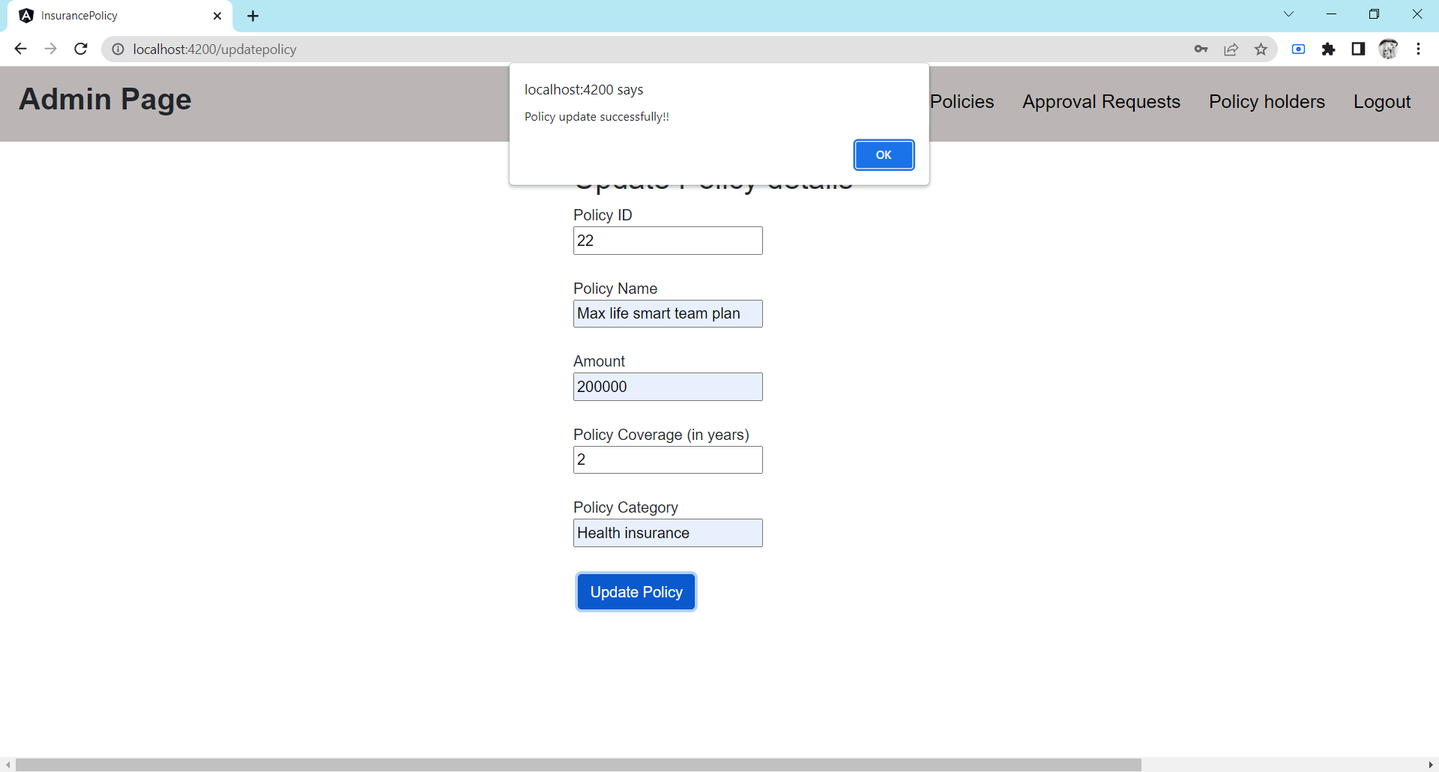

Slide 28
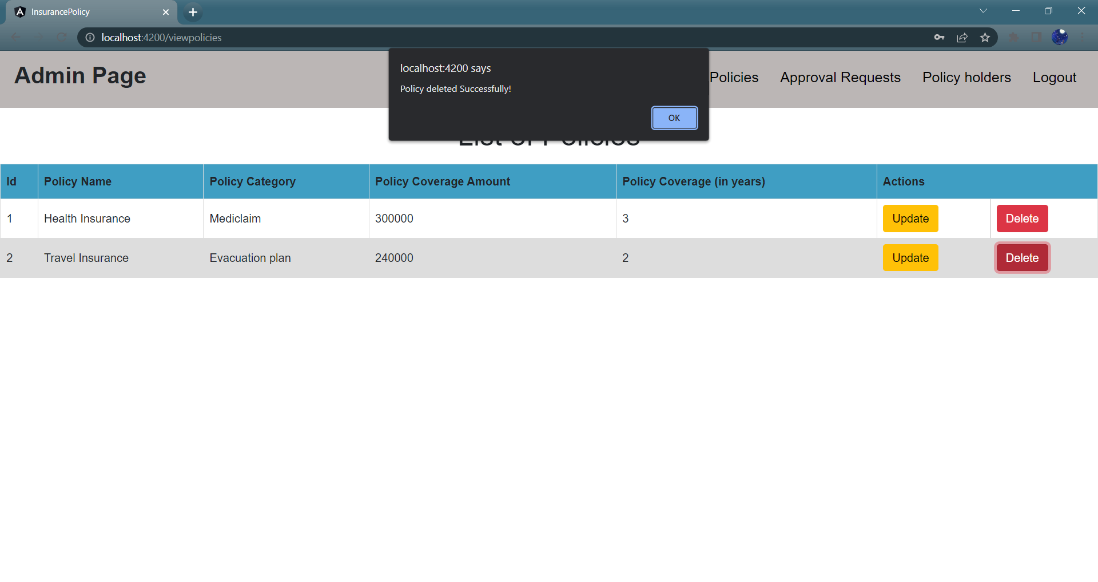

Slide 29
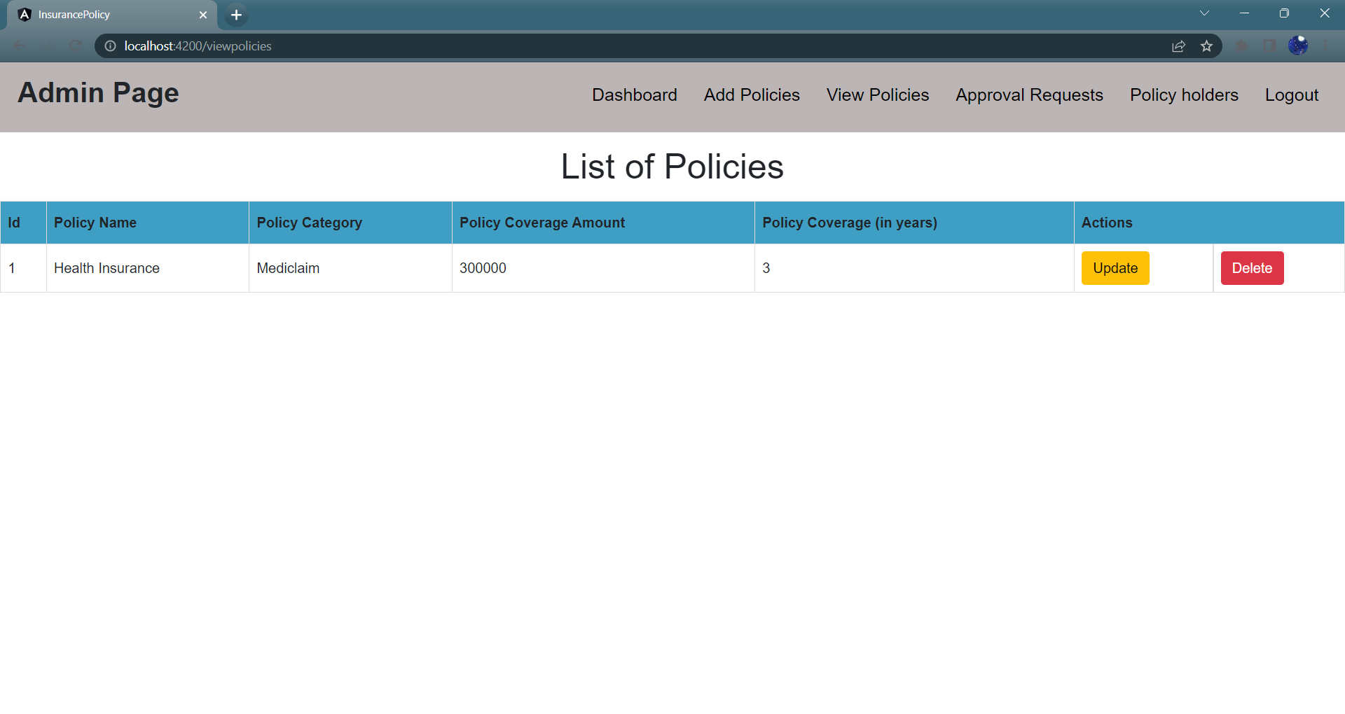

Slide 30
Admin Operations Cont’d,
Approval requests page:
After admin login to the portal, he/she can view the requests send by the users and customers on the policies list they wish to apply with the ID of the policy they wish to apply
Admin has two options such as approve or disapprove to approve or disapprove the policy applied by the user.
The screenshot of the approval requests page is as follows:

Slide 31
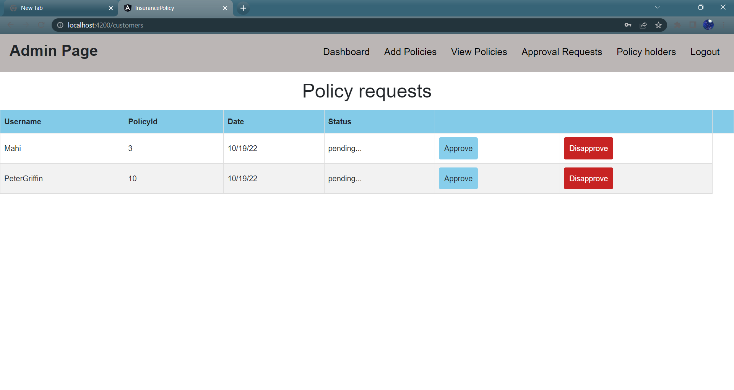

Slide 32
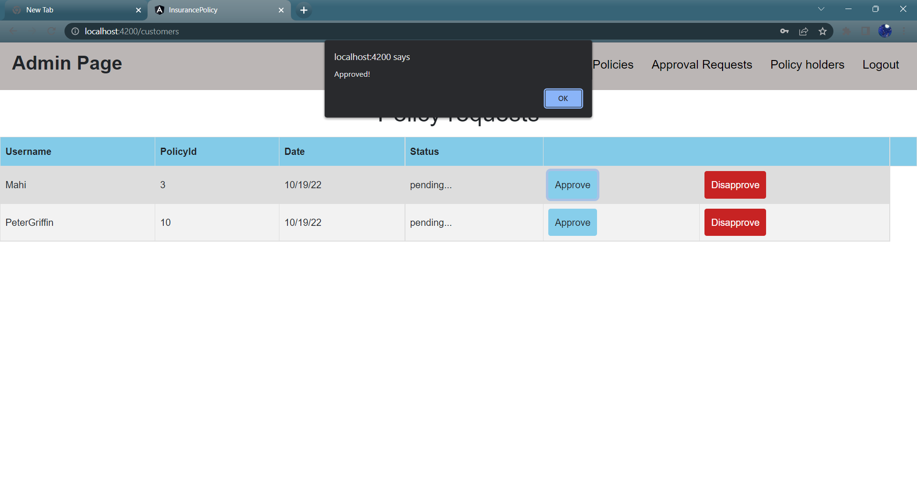

Slide 33
Admin Operations Cont’d,
Policy holders page:
This is the page where the admin operation which include the viewing of the customers list which has the table that shows the list of customers who had applied for the policy which is either approved or dis-approved by the admin
In simple terms, this is the page where the admin can see the history of approved or dis-approved policy holders.
After doing all the operations, the admin can logout by clicking the logout button which will be navigated to the home or launching page
The screenshot of the policy holders page is as follows:

Slide 34
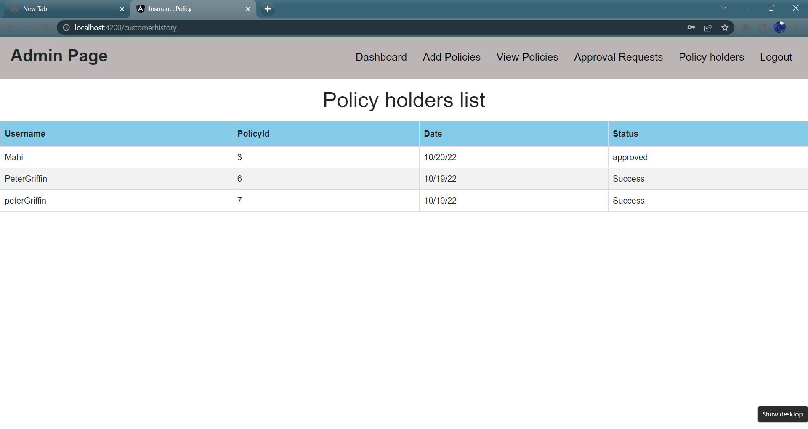

Slide 35
USER registration:
This web application “Insurance Policy Management”, has another main module which is the customer or user module
In this module, before accessing the user operation page, the customer or user has to be logged in to the portal
But for logging in, he/she has to create an account in the portal.
This user registration page has been designed using the angular which acts as a tool for front end needs and has used the spring boot for server side connectivity
This includes a form for creating the new account for the user or customer which prompt for the details of the user like user name, account number, mobile number, email address and password
The screenshot of the user registration page is as follows:

Slide 36
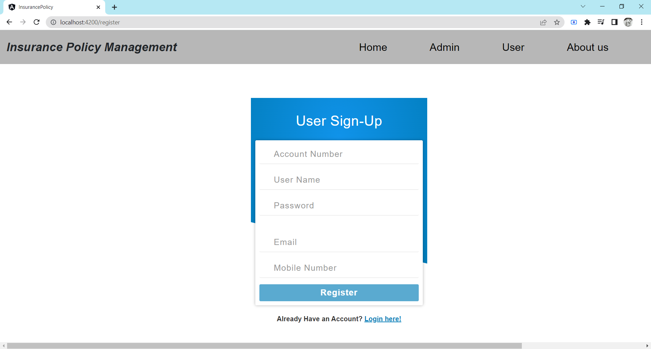

Slide 37
USER Login:
After the successful registration of user or customer or the after the successful creation of new account, the user will be navigated to the user login page
The user login page which will be considered as mandatory for logging in to or accessing the home page of user or customer
This user login page includes a form for entering the username and the password that is created by the user on the phase of registration and can log in to the portal
The screenshot of the user login page is as follows:

Slide 38


Slide 39


Slide 40
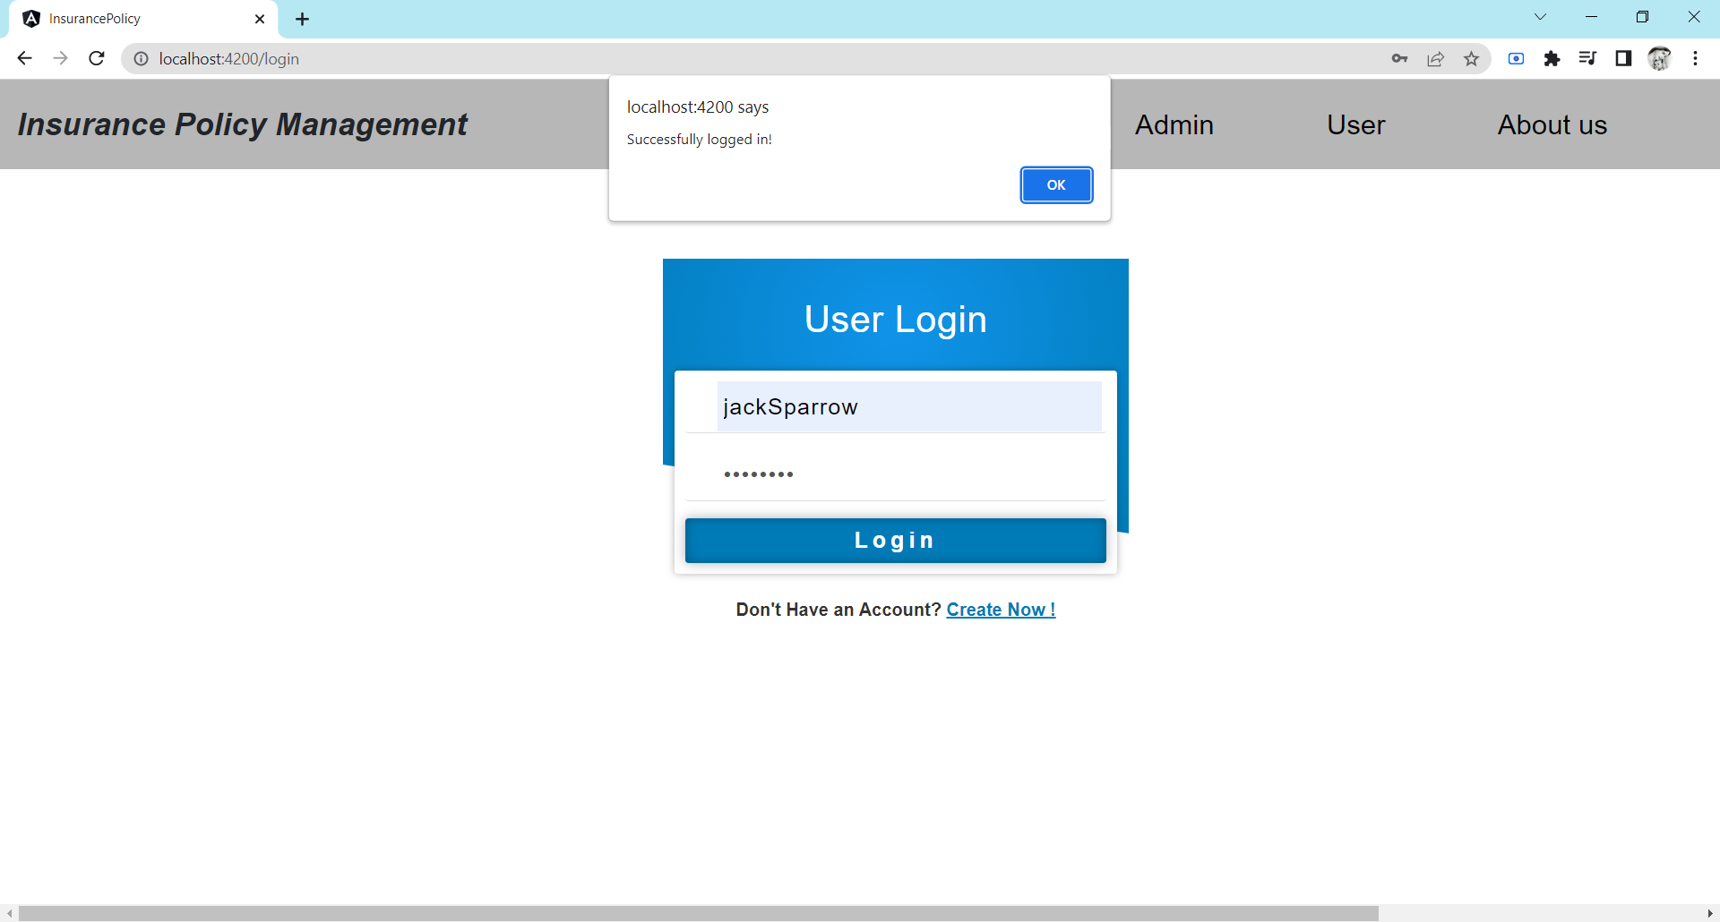

Slide 41
USER OPERATIONS:
User Dashboard page:
After logging in using the user login page or form, the user will then be navigated to the user dashboard page where the user has various option to navigate to various pages which includes update user details page, a page to view and apply for the policy added by the admin and a page to send the feedback
Update user details page:
This web page which has the form that allows the user to update their details which is given in the phase of registration and will be updated as given by the user
The screenshot of the user dashboard page and update user details page is as follows:

Slide 42
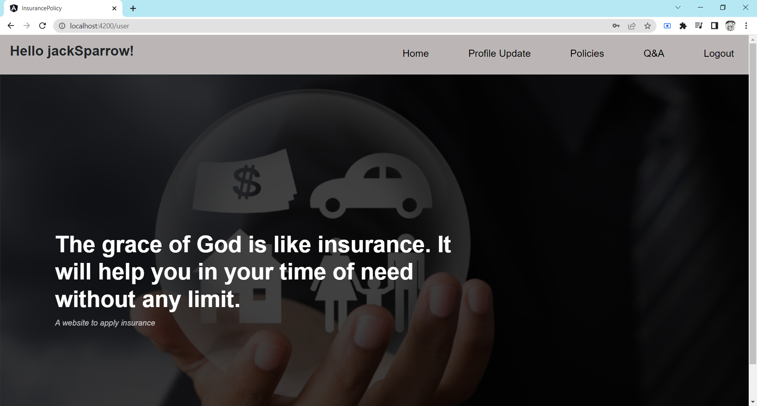

Slide 43
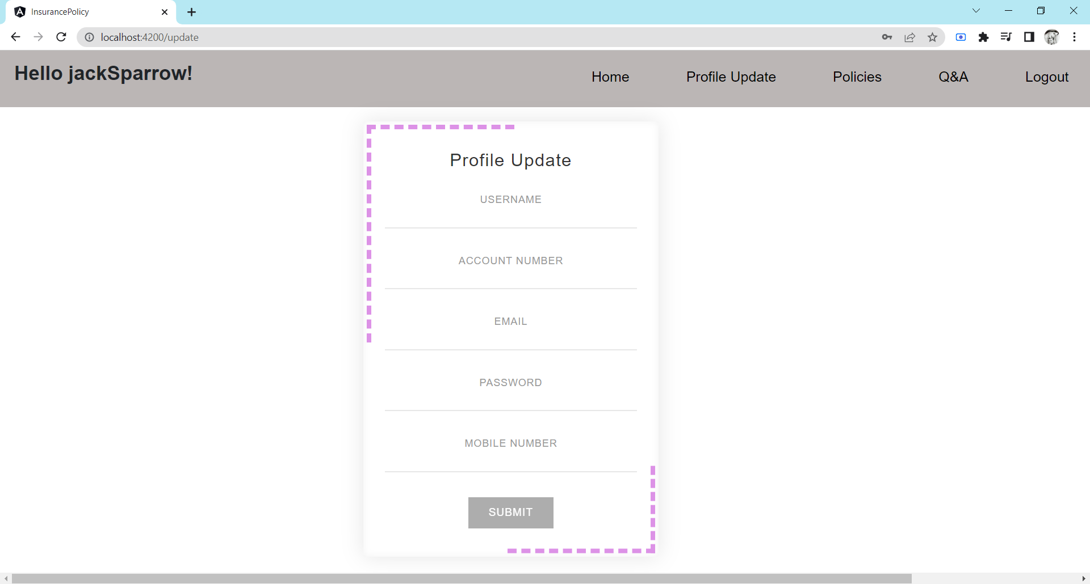

Slide 44
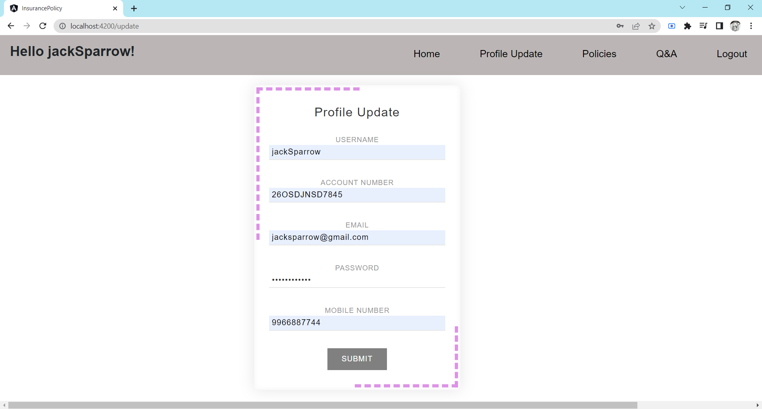

Slide 45
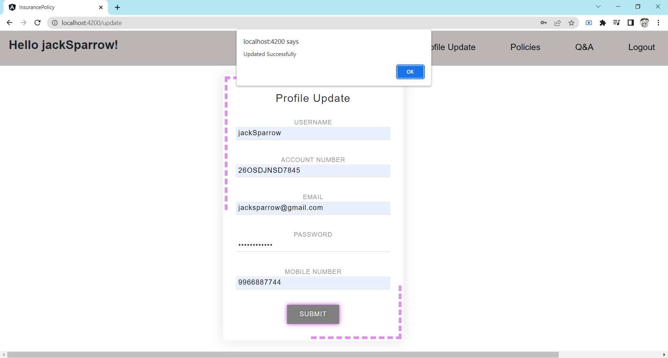

Slide 46
USER OPERATIONS cont’d:
View Policies page:
This view policies page allows the user to view the list of policies with their policy name, category, and policy coverage year and amount and has a action button to apply for the same
When the user wish to apply for the policy he/she likes they can apply for the policy by clicking the apply button which in turn send the request for the approval to the admin
Q and A page:
This web page is the page that allows the user to send any queries to the admin if they need
Logout:
The user can logout from their account by clicking on the logout button
The screenshot of the view policies page and Q and A page is as follows:

Slide 47
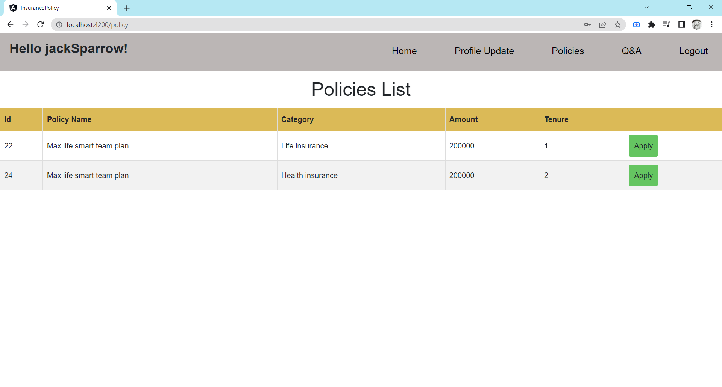

Slide 48
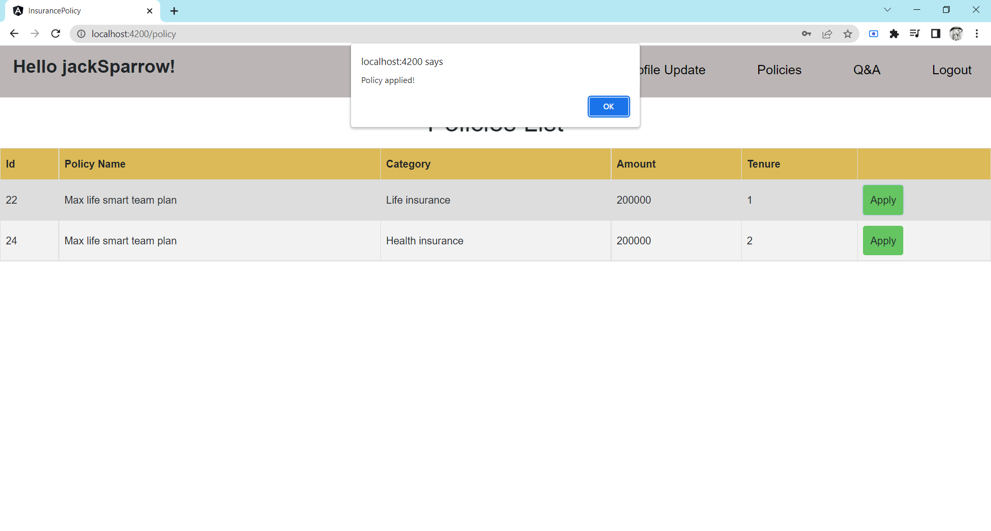

Slide 49
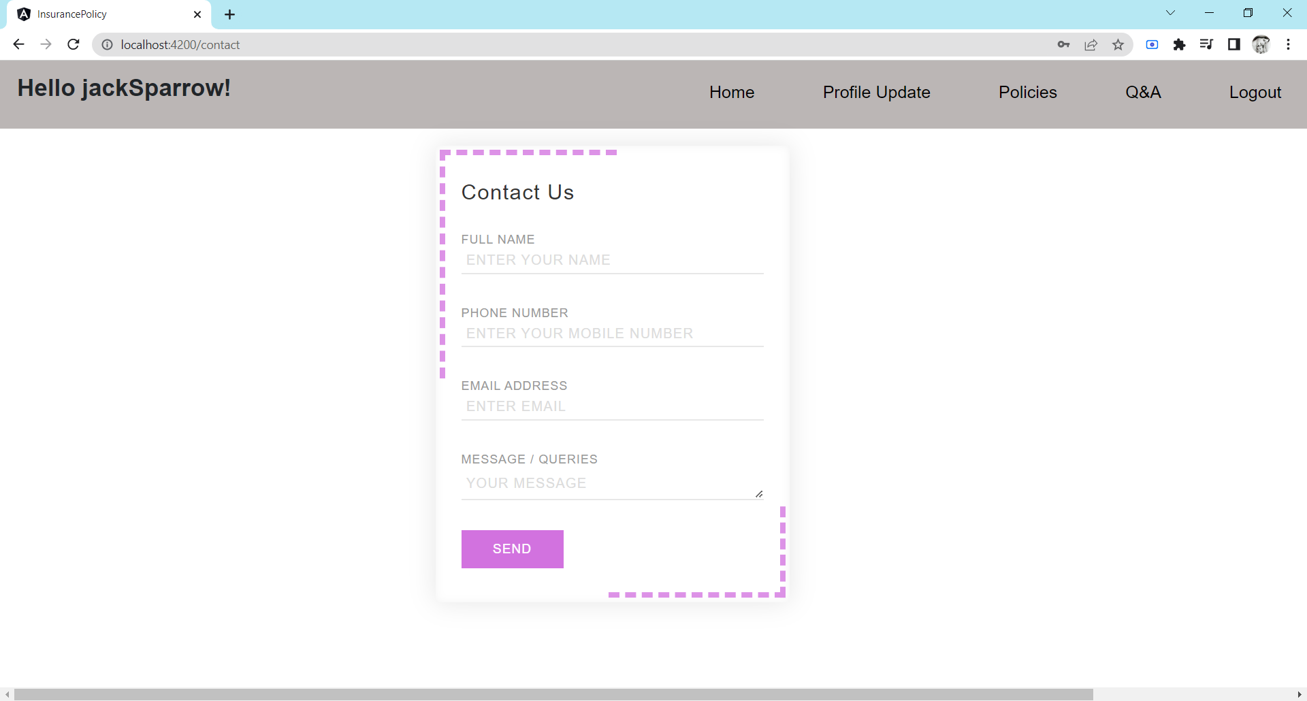

Slide 50
CONCLUSION
By using this web application “Insurance Policy management”, the insurance organizations has the ability to reach their customers directly without involving any other mediators, brokers or agents.
The customers can easily check the various policies, can compare them with one another and can able to enroll in the desired one they wish which makes it easier for the customers or users indeed

Slide 51
Thank you

